Slide 1
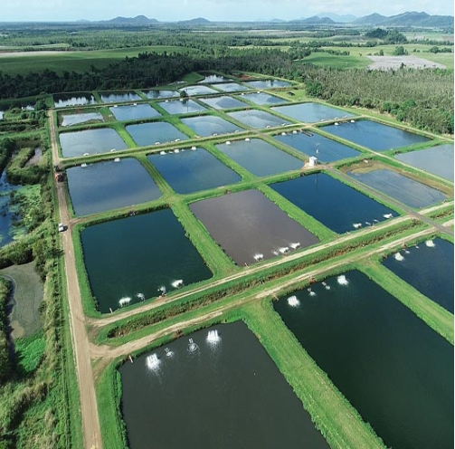
Aquaculture Pond Health Monitoring Using Sentinel-2 Data and Deep Learning Predicting Water Quality and Future States

Slide 2
Aim
To monitor the health of aquaculture ponds using Sentinel-2 satellite imagery and deep learning techniques, and to predict the future states of water quality parameters for 15 days and 30 days, providing comprehensive visualizations and detailed reports for better management and decision-making.

Slide 3
Overview of Aquaculture and Its Importance
Aquaculture, also known as aquafarming, is the cultivation of aquatic organisms such as fish, crustaceans, mollusks, and aquatic plants. This practice includes freshwater and saltwater populations under controlled conditions. Aquaculture has grown rapidly due to its importance in providing a reliable source of protein, supporting livelihoods, and contributing to food security worldwide.
Importance of Aquaculture
Food Security: Aquaculture significantly contributes to the global food supply. It helps meet the rising demand for fish and seafood, which are vital sources of protein and essential nutrients.
Economic Growth: The aquaculture industry supports millions of jobs globally, from fish farming and feed production to processing and distribution.
Sustainability: When managed sustainably, aquaculture can reduce pressure on wild fish stocks, helping to preserve marine ecosystems.
Rural Development: Aquaculture operations, often located in rural areas, provide employment and development opportunities in these regions.
Research and Innovation: Advances in aquaculture practices and technologies drive innovation in areas such as genetics, nutrition, and disease management.

Slide 4
Challenges in Monitoring Pond Health
Water Quality Management: Ensuring optimal water quality is essential. Parameters like temperature, pH, dissolved oxygen, and ammonia levels must be regularly monitored and maintained within specific ranges.
Disease Detection and Management: Aquaculture is susceptible to various diseases that can spread rapidly. Early detection and effective management of diseases are challenging but crucial to prevent significant losses.
Nutrient Management: Managing the balance of nutrients in the water to prevent eutrophication and harmful algal blooms while ensuring adequate growth conditions for the cultured species.
Environmental Impact: Monitoring and minimizing the environmental impact of aquaculture activities on surrounding ecosystems.
Data Collection and Analysis: Collecting accurate and timely data on pond conditions and interpreting this data to make informed management decisions.
Cost and Accessibility: Implementing comprehensive monitoring systems can be costly and may not be accessible to all aquaculture operations, particularly small-scale farmers.

Slide 5
Role of remote sensing &AI/ML in aquaculture
Water Quality Monitoring:
Turbidity: Remote sensing can detect water turbidity levels, which indicate the concentration of suspended particles. High turbidity can harm fish health and indicate poor water quality.
Chlorophyll Concentration: Satellites can measure chlorophyll levels, indicating phytoplankton abundance, which affects water quality and fish health.
Surface Temperature: Thermal sensors can monitor water surface temperatures, crucial for maintaining optimal conditions for aquaculture species.
Disease Surveillance:
Environmental Indicators: Changes in water quality parameters detected by remote sensing can signal stress in aquatic organisms, potentially indicating the onset of disease outbreaks.
Algal Blooms: Remote sensing can identify harmful algal blooms that can cause fish kills and affect water quality.
Environmental Impact Assessment:
Habitat Monitoring: Remote sensing can track changes in coastal and inland water habitats, assessing the impact of aquaculture on surrounding ecosystems.
Nutrient Runoff: It can detect nutrient runoff from aquaculture farms into surrounding water bodies, helping manage and mitigate environmental impacts.
Efficient Data Collection:
Large-Scale Monitoring: Remote sensing covers large and remote areas, providing comprehensive data without the need for extensive in-situ sampling.

Slide 6
Role of AI Techniques in Aquaculture
Data Analysis and Interpretation:
Machine Learning Algorithms: AI can process and analyze vast amounts of remote sensing data to identify patterns and trends, providing insights into water quality, fish health, and environmental conditions.
Predictive Analytics: AI models can predict future conditions and potential issues based on historical data, enabling proactive management.
Automated Monitoring Systems:
Real-Time Alerts: AI systems can provide real-time alerts for sudden changes in water quality or environmental conditions, allowing for immediate action.
Continuous Monitoring: AI enables continuous monitoring of aquaculture systems, reducing the need for manual inspections and interventions.
Disease Detection and Prevention:
Image Analysis: AI can analyze images from remote sensing and underwater cameras to detect early signs of disease or stress in fish, improving response times.
Behavioral Monitoring: AI can monitor fish behavior through video analysis, identifying unusual patterns that may indicate health issues.

Slide 7
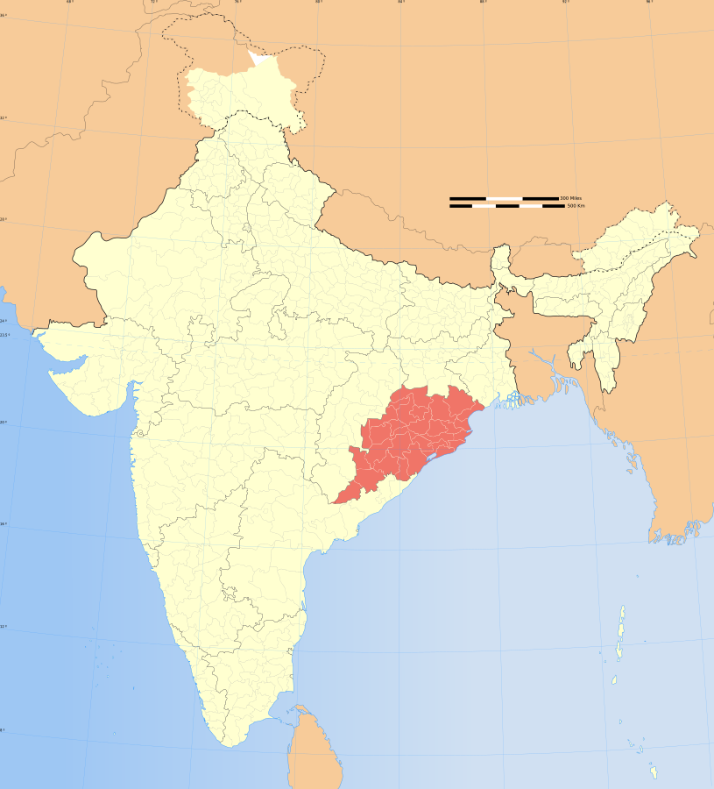
Area of Interest Odisha, Balasore

Slide 8
Procedure
Data collection
Remote Sensing Technology
Sentinel-2 Satellite Imagery:
Sentinel-2 is a high-resolution multi-spectral imaging mission from the European Space Agency (ESA), part of the Copernicus Programme.
It provides images in 13 spectral bands, which are useful for various applications, including agriculture, forestry, and water quality monitoring.
The imagery is available at a spatial resolution of 10 to 60 meters, depending on the band, with a revisit time of approximately five days.
Area of Interest (AOI)
Defining the AOI:
The study focused on specific aquaculture ponds within a defined geographical area.
A polygon was created to delineate the boundaries of the AOI, ensuring targeted data collection.
Time Range
Time Frame:
Data was collected for a specific time range to analyze seasonal variations and trends in water quality.
For this project, the time range covered the entire year of 2023, providing a comprehensive dataset.

Slide 9
Classifying aquaculture pond health status into categories such as poor, moderate, and healthy based on parameters
Dissolved Oxygen (DO)
Dissolved oxygen is crucial for the survival and growth of aquatic organisms. Low DO levels can indicate poor water quality.
Healthy: DO > 5 mg/L
Moderate: DO 3-5 mg/L
Poor: DO < 3 mg/L
Calculation of DO
Total Suspended Solids (TSS)
High TSS levels can reduce light penetration and affect the growth of phytoplankton, which is essential for the food web in aquaculture ponds.
Healthy: TSS < 25 mg/L
Moderate: TSS 25-80 mg/L
Poor: TSS > 80 mg/L
(TSS = (B4 / B3)^2.1 * 0.1721)

Slide 10
Cont…
pH
The pH level affects the toxicity of ammonia and the overall health of aquatic organisms. Extreme pH values can be detrimental.
Healthy: pH 6.5-8.5
Moderate: pH 6.0-6.5 or 8.5-9.0
Poor: pH < 6.0 or > 9.0
(pH = (B3 / B2) * 2 + 6)
Chlorophyll-a (Chlorophyll A)
Chlorophyll-a is a proxy for phytoplankton biomass and is an important indicator of the trophic status of water bodies. High chlorophyll-a levels can indicate eutrophic conditions, which can lead to poor water quality and harmful algal blooms.
Healthy: Chlorophyll-a < 0.01 mg/m³
Moderate: Chlorophyll-a 0.01-0.02 mg/m³
Poor: Chlorophyll-a > 0.02 mg/m³

Slide 11
Development of Deep learning models
Image Segmentation based model(In situ field Data based)
Multilayer Perceptron (MLP)(feedforward neural network)(Satellite Data)

Slide 12
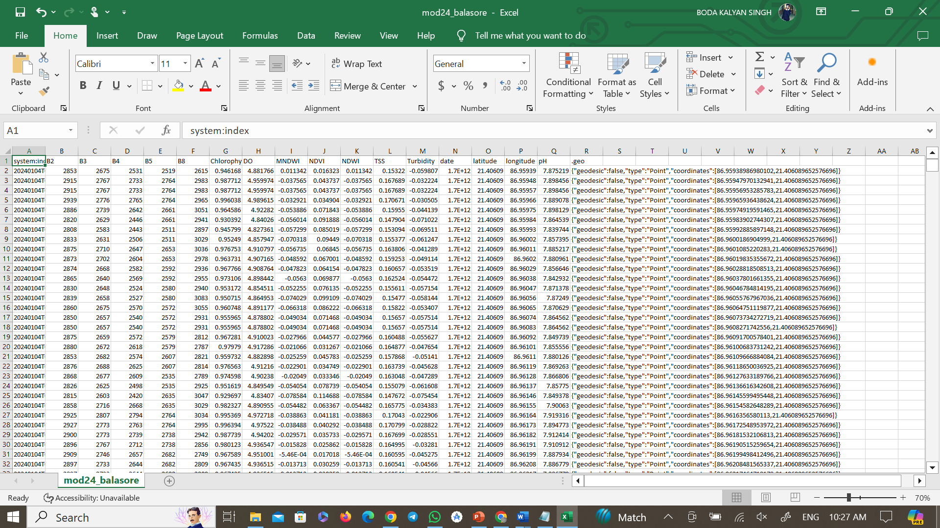
The extracted Data format

Slide 13
Data Processing
1. Data Loading
Description: Load the existing dataset from 2023 and the new dataset for January-February 2024.
import pandas as pd
data_2023 = pd.read_csv('/path/to/Sentinel2_Water_Quality.csv')
data_2024 = pd.read_csv('/path/to/Sentinel2_Water_jan_feb24.csv’)
2. Data Type Conversion
Description: Ensure latitude and longitude are in the correct format (float) to avoid any issues during processing.
data_2023['latitude'] = data_2023['latitude'].astype(float)
data_2023['longitude'] = data_2023['longitude'].astype(float)
data_2024['latitude'] = data_2024['latitude'].astype(float)
data_2024['longitude'] = data_2024['longitude'].astype(float)

Slide 14
Data processing
Feature Selection and Target Variable
Description: Select relevant features (e.g., spectral bands and water quality parameters) and define the target variable (health_status).
Target Variable: For demonstration, a synthetic health status based on Chlorophyll a is created.
Feature Scaling
Description: Standardize the features to ensure they have a mean of 0 and a standard deviation of 1, which helps improve the performance of the neural network.
Model Training
Description: Train the neural network model using the processed data.
Key Layers: Input layer, hidden layers with ReLU activation, dropout layers to prevent overfitting, and an output layer with sigmoid activation for binary classification.

Slide 15
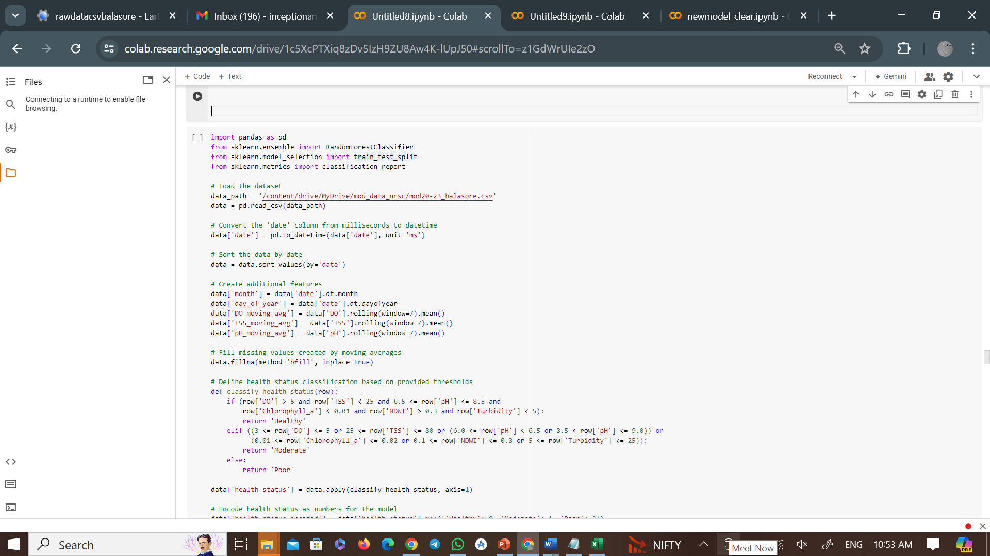
Development of Model

Slide 16
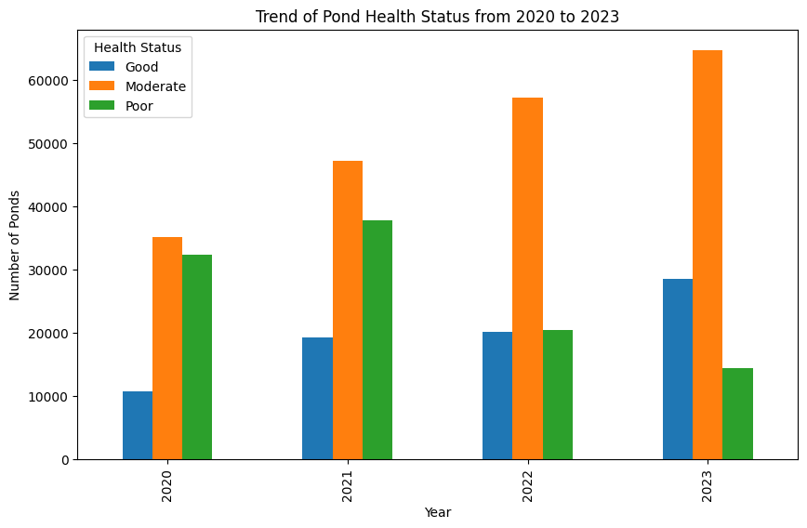
Trend of pond health status from 2020-2023

Slide 17
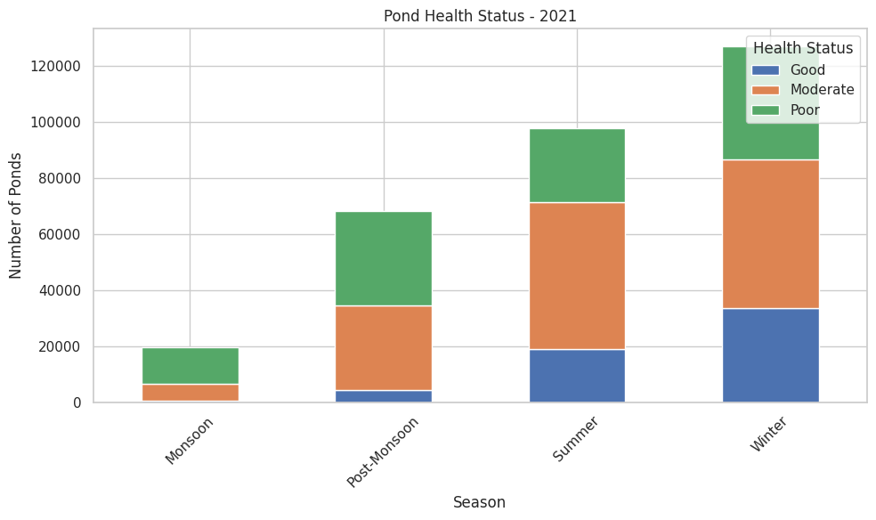
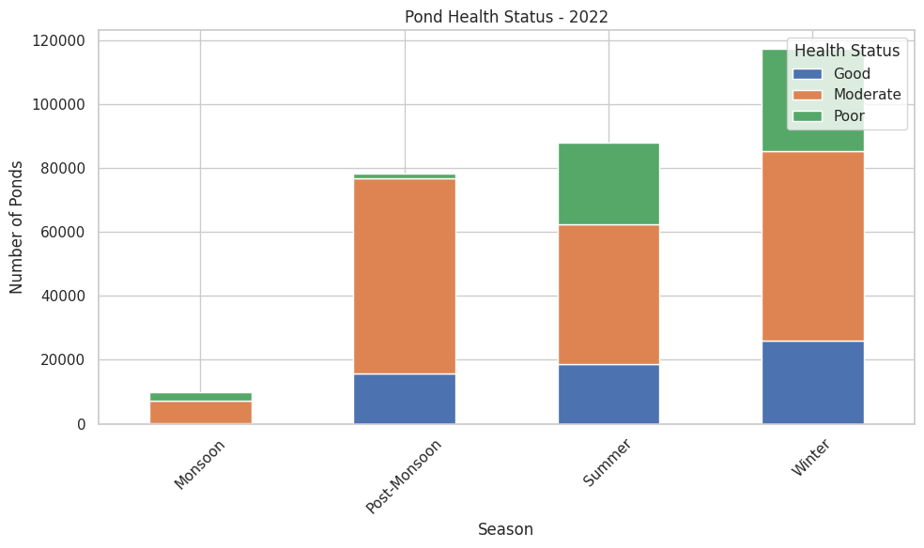
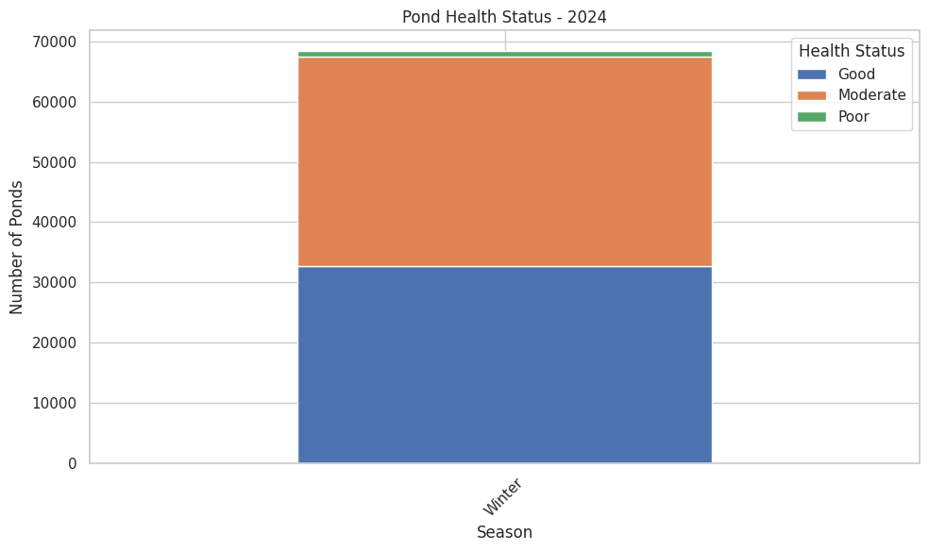
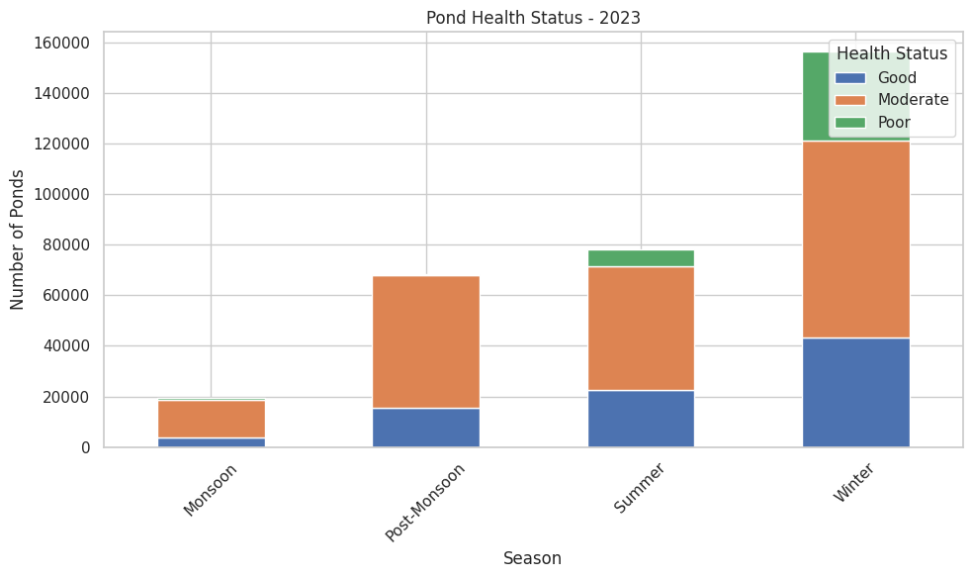
.

Slide 18
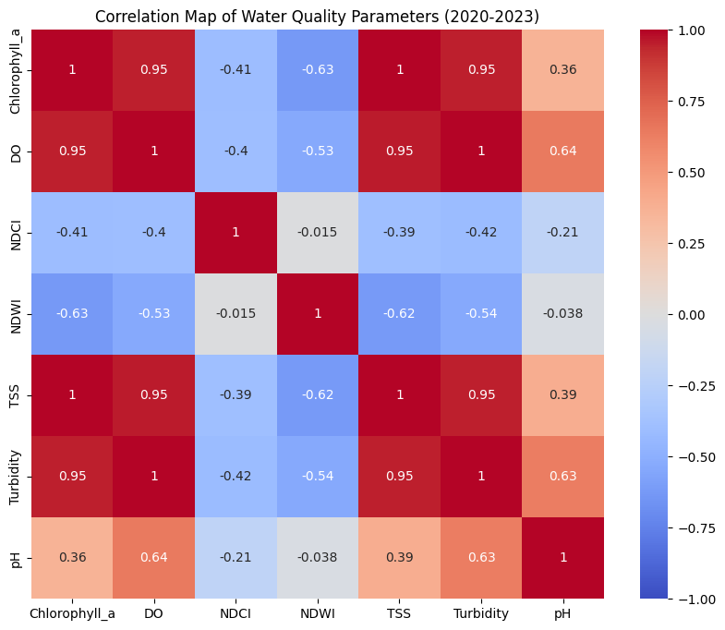
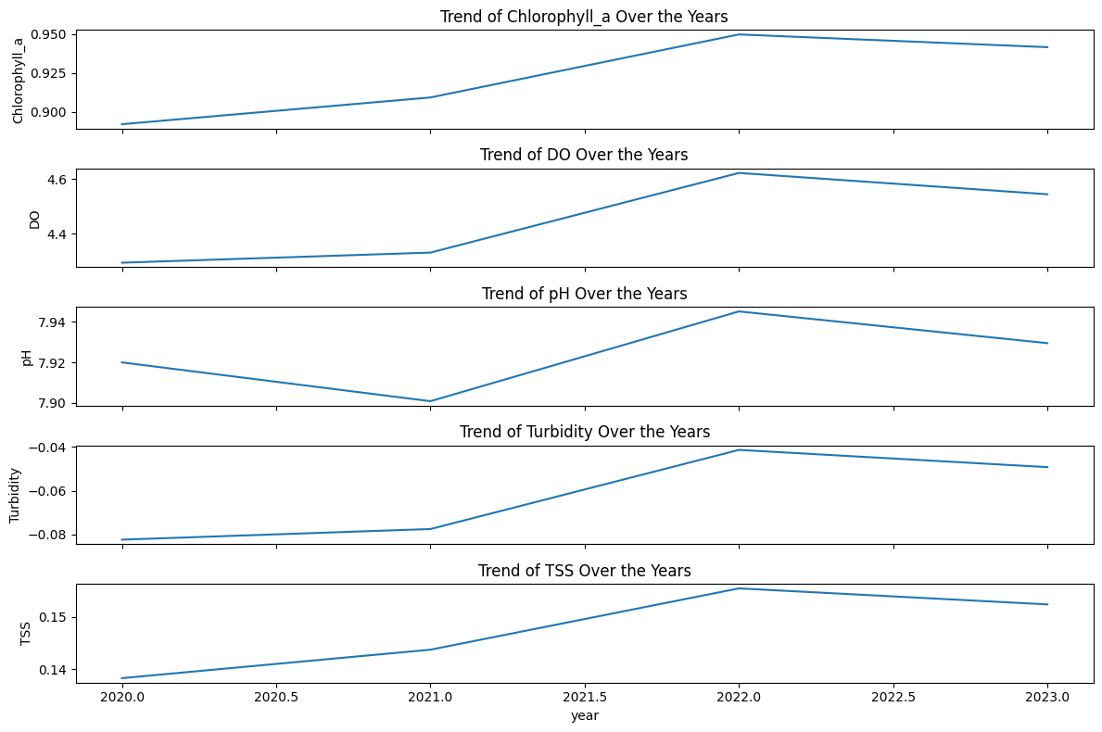
Correlation Map of water Quality Parameters(2020-2023)

Slide 19
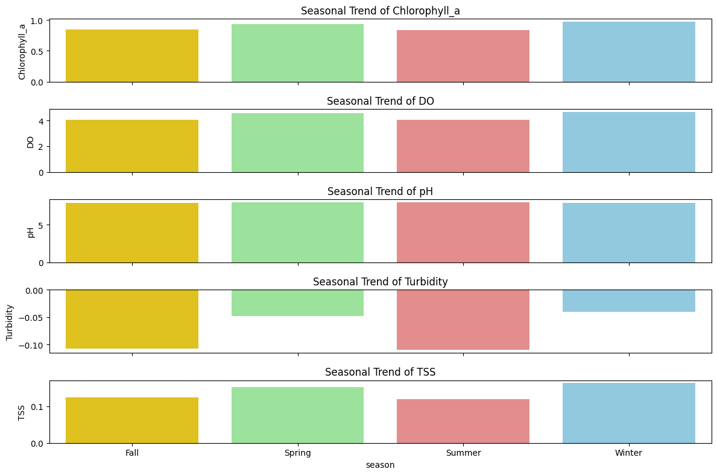
Seasonal Trend of Water quality parameters

Slide 20
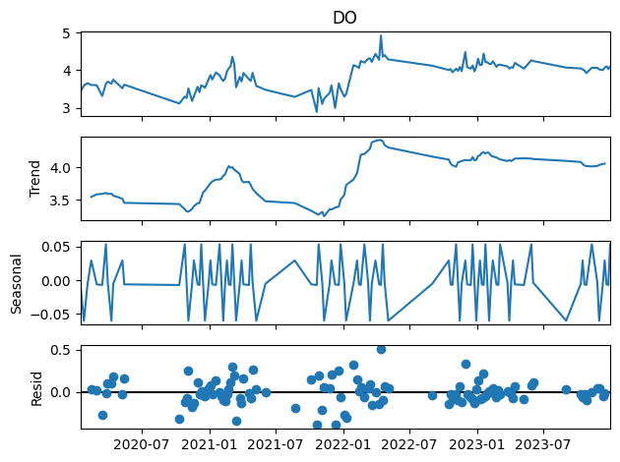
Variation of Water quality parameters

Slide 21
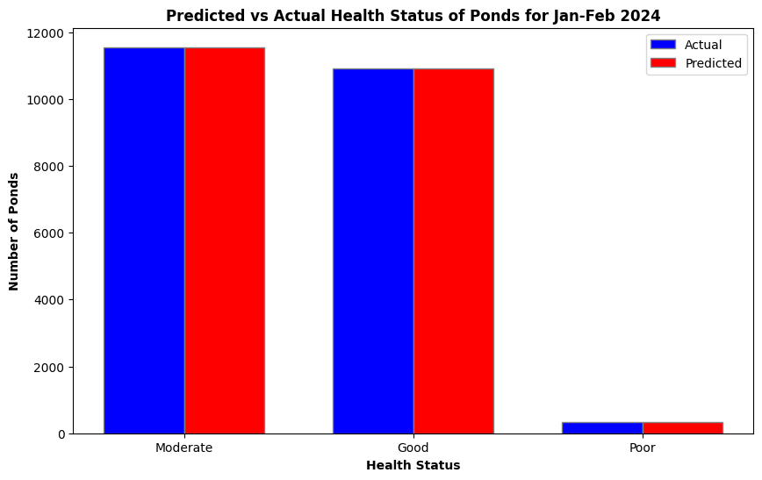
Predicting the Health Status of Ponds in 2024 using Machine Learning Models Trained on 2020-2023 Data

Slide 22
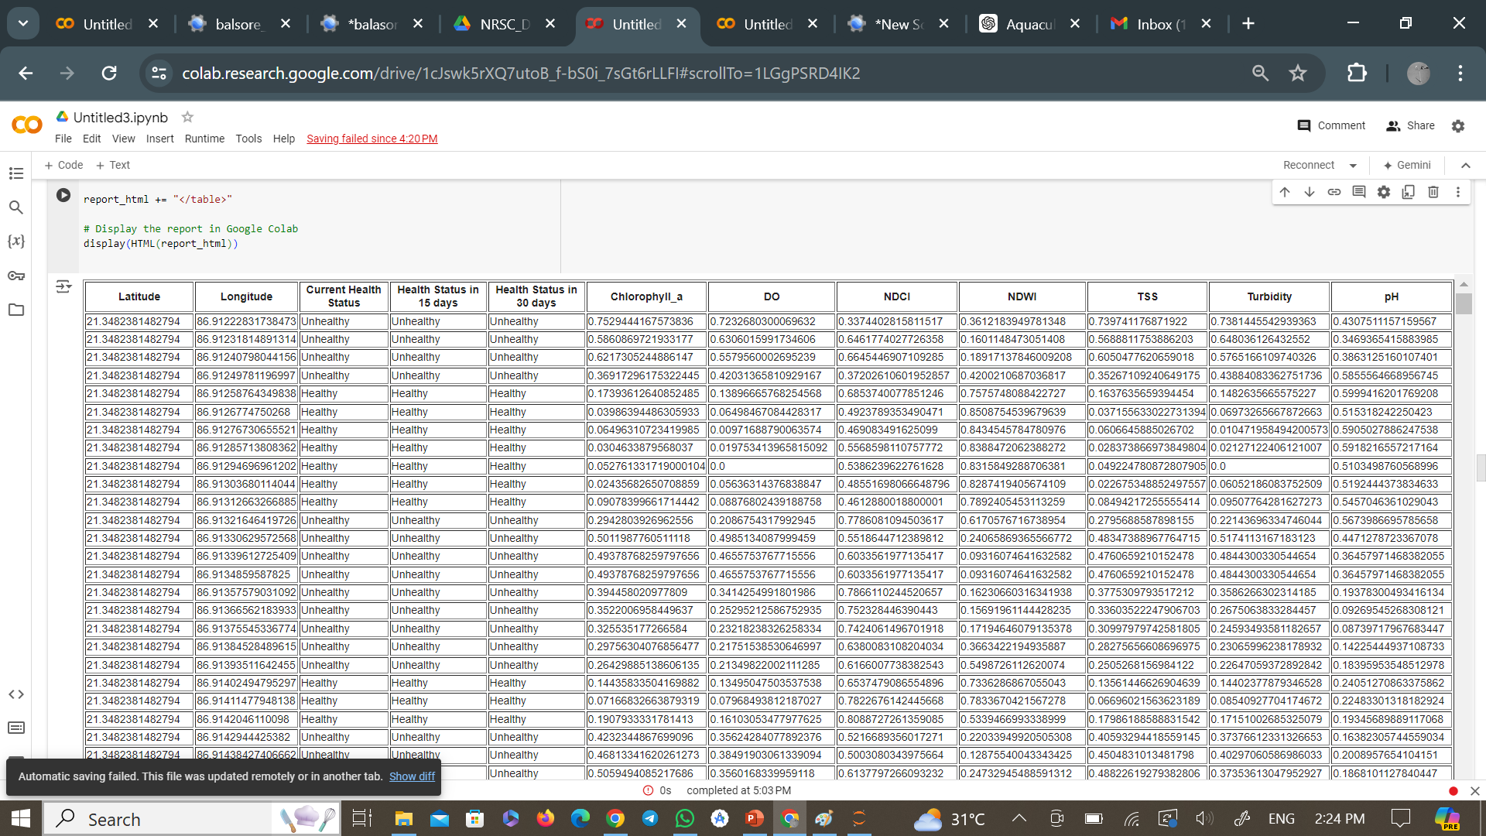
Output of the model

Slide 23
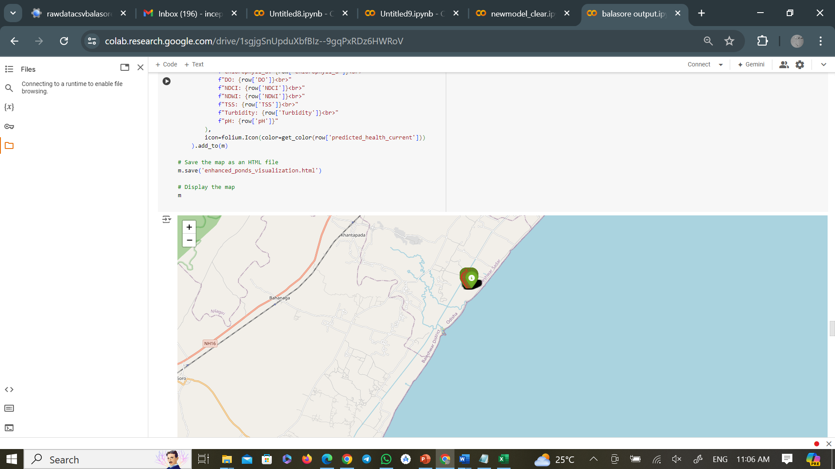
Live output of the Model

Slide 24
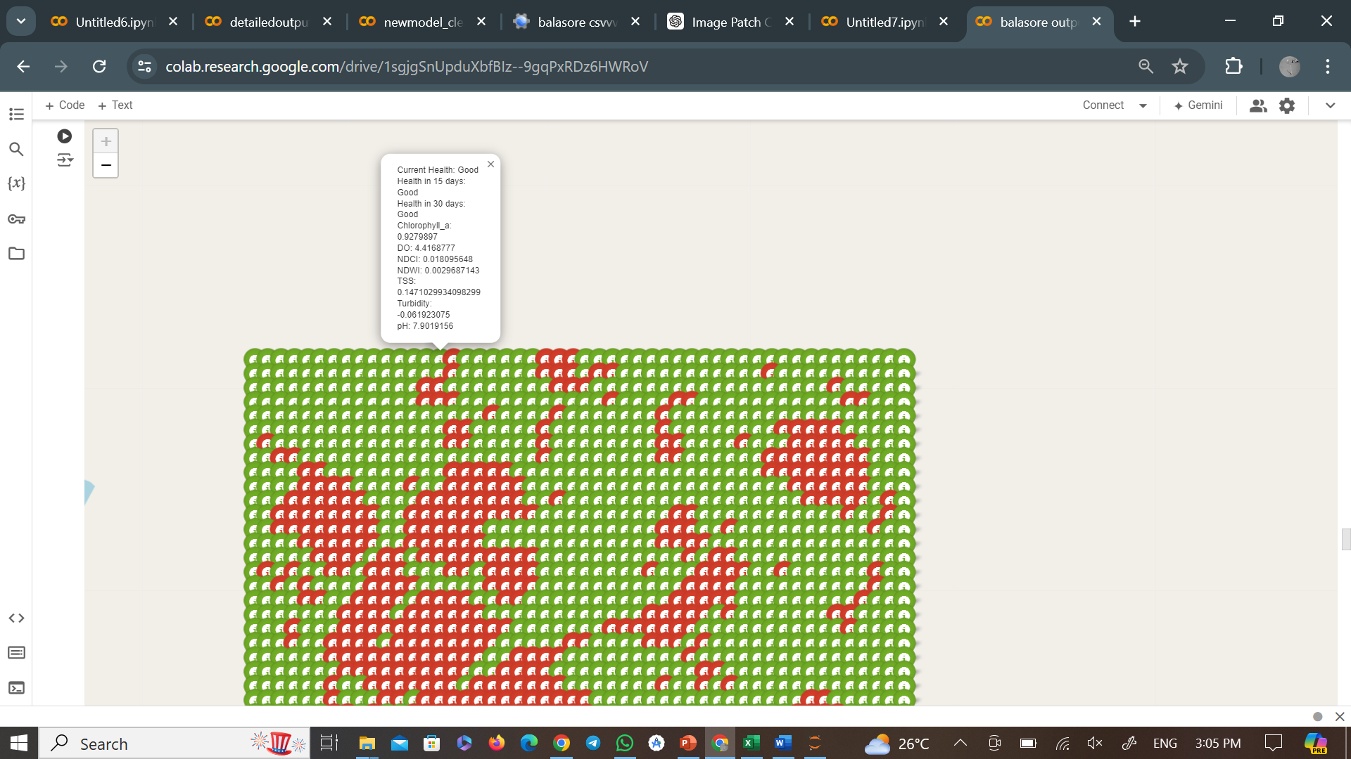
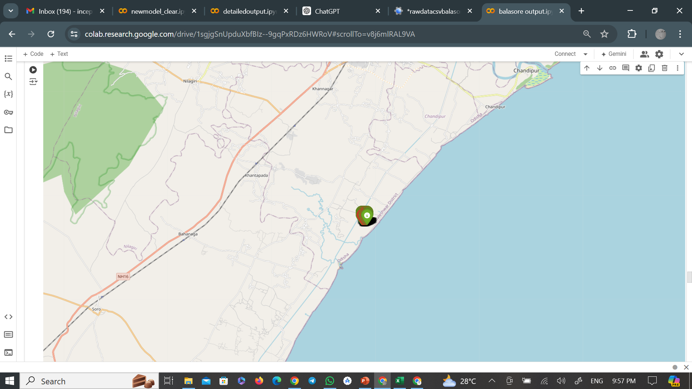
Locating the point of Pond

Slide 25
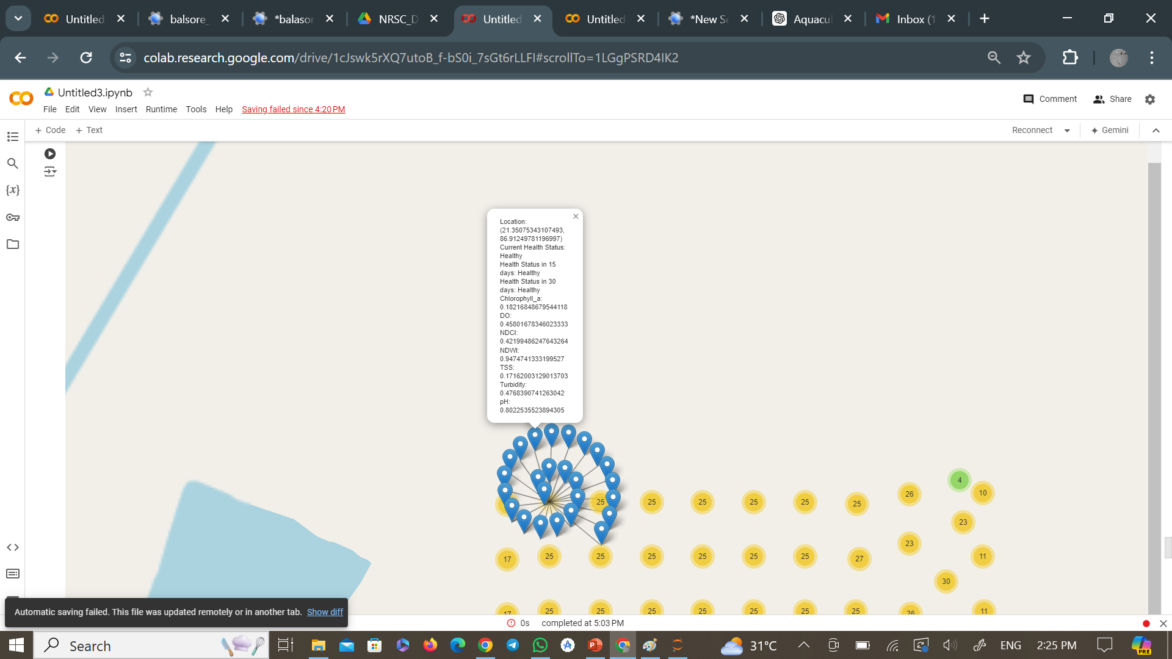
Output of the model

Slide 26
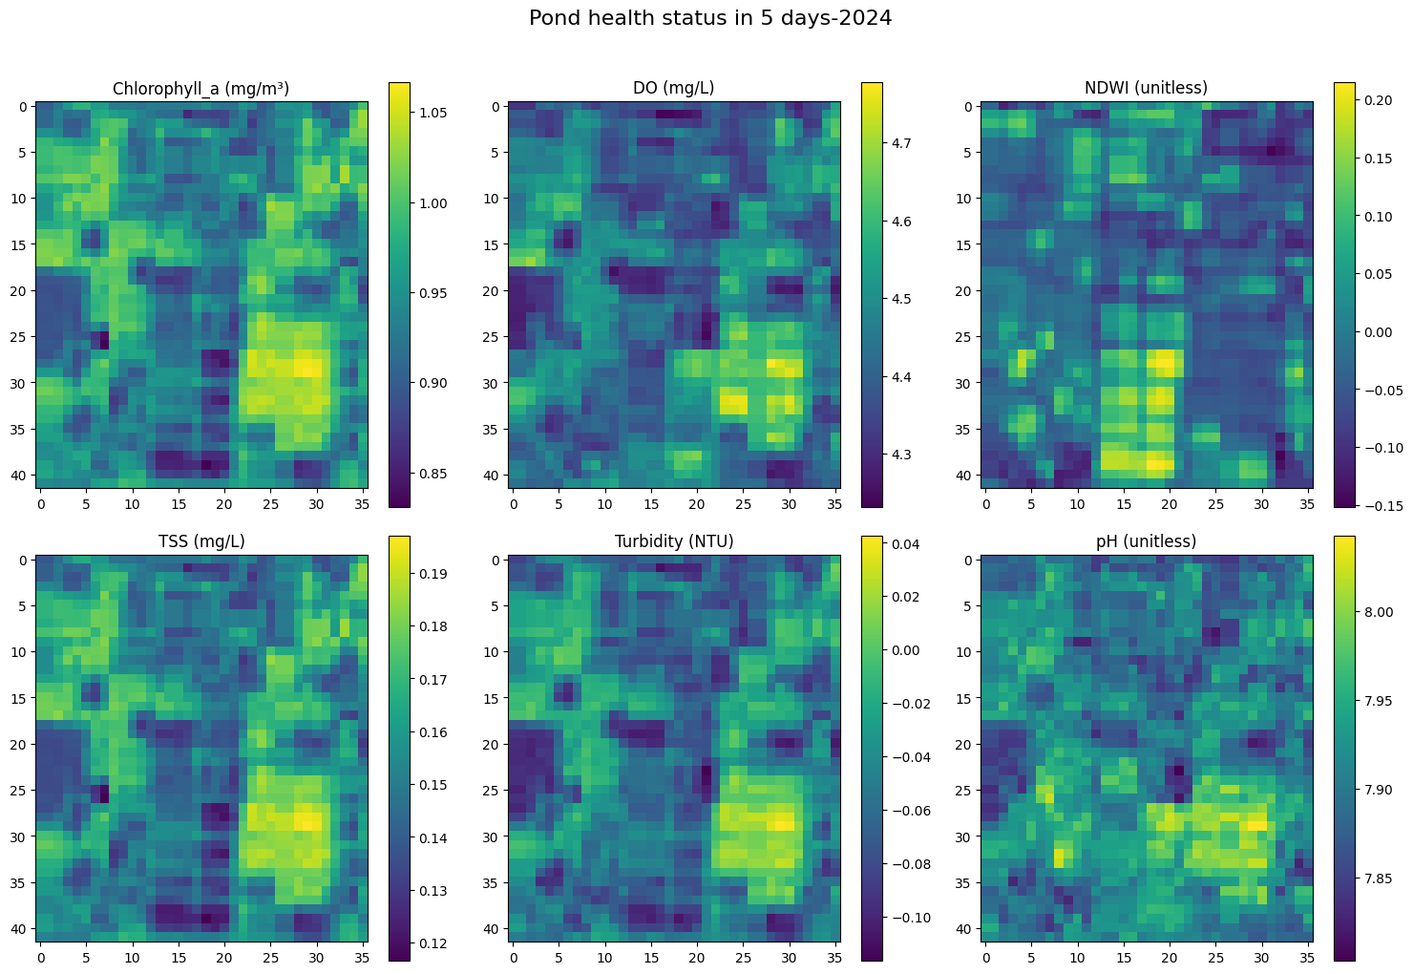
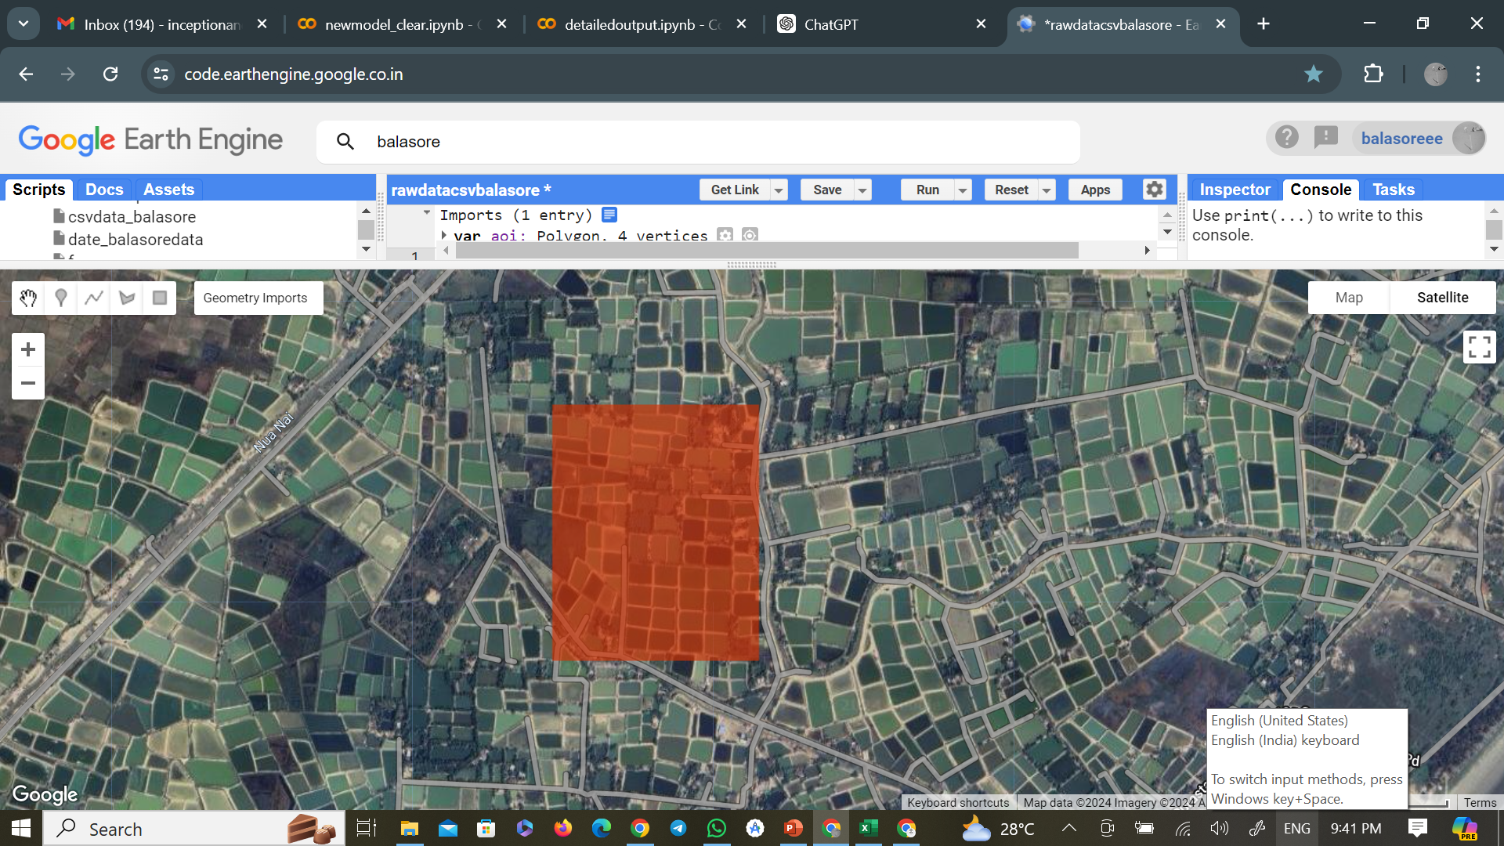
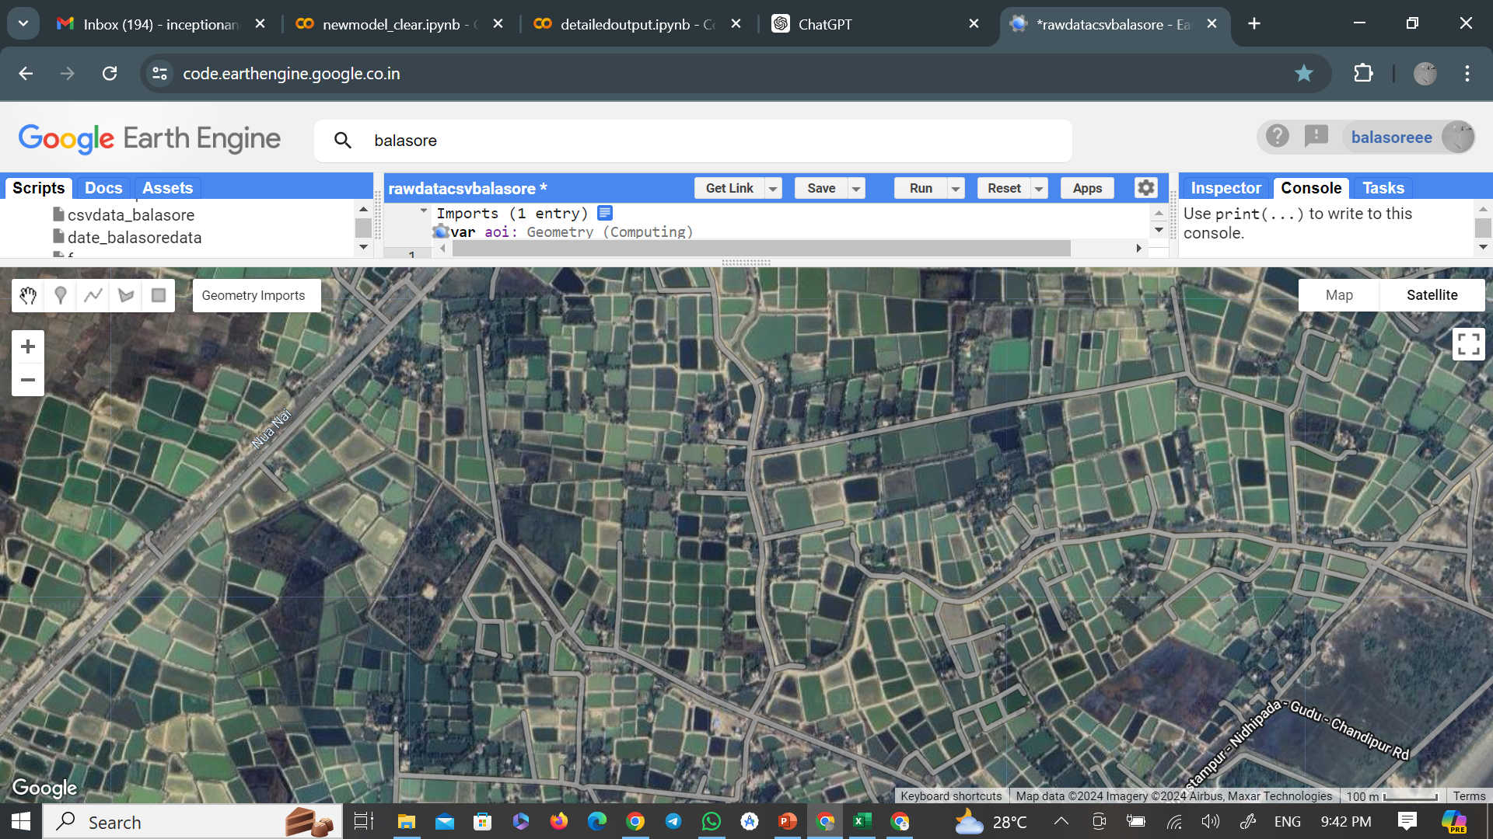
Output of the model
.

Slide 27
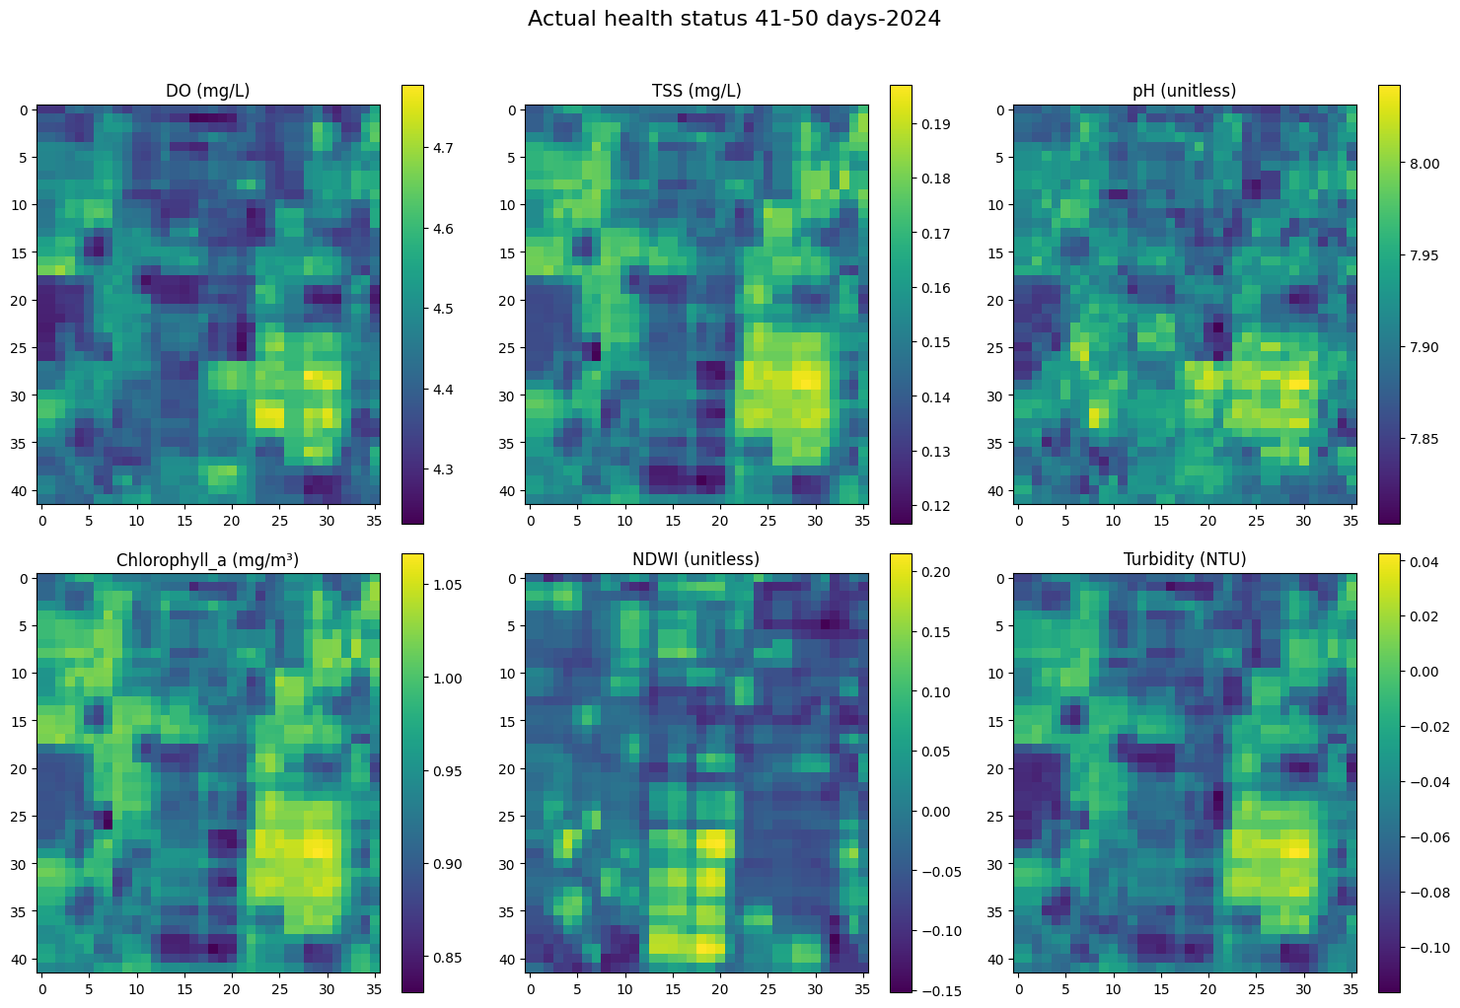

Actual vs Predicted

Slide 28
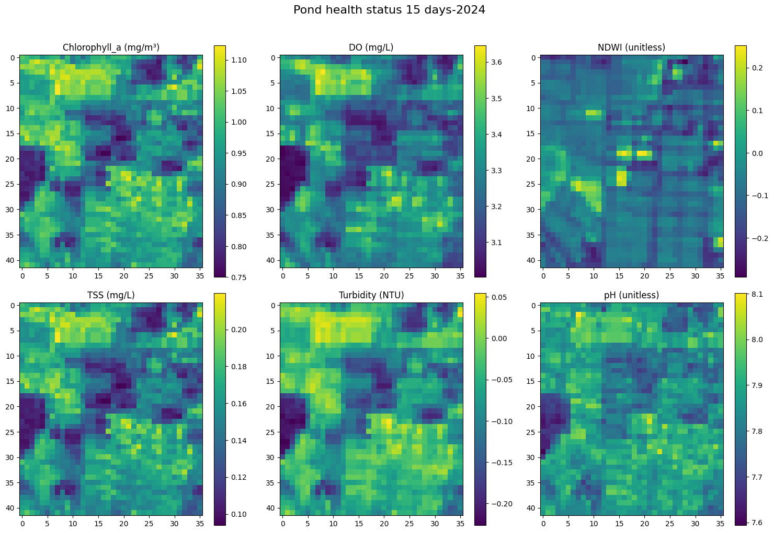

.

Slide 29
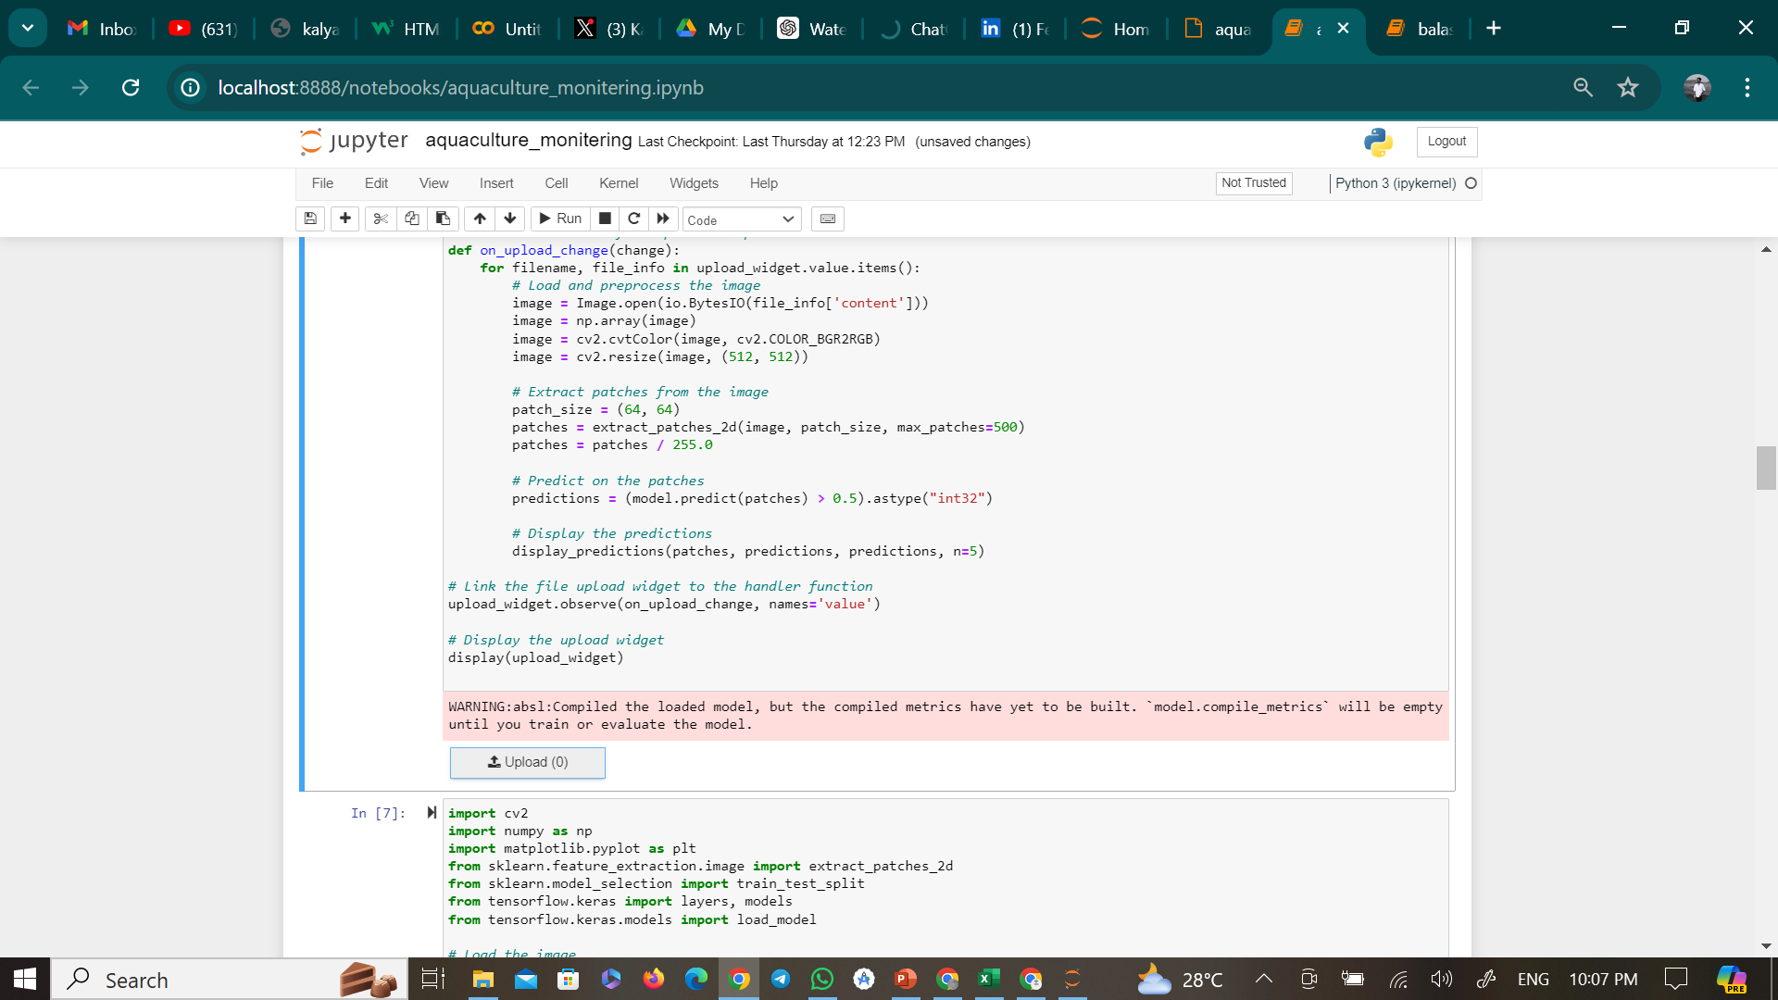
Model-2

Slide 30
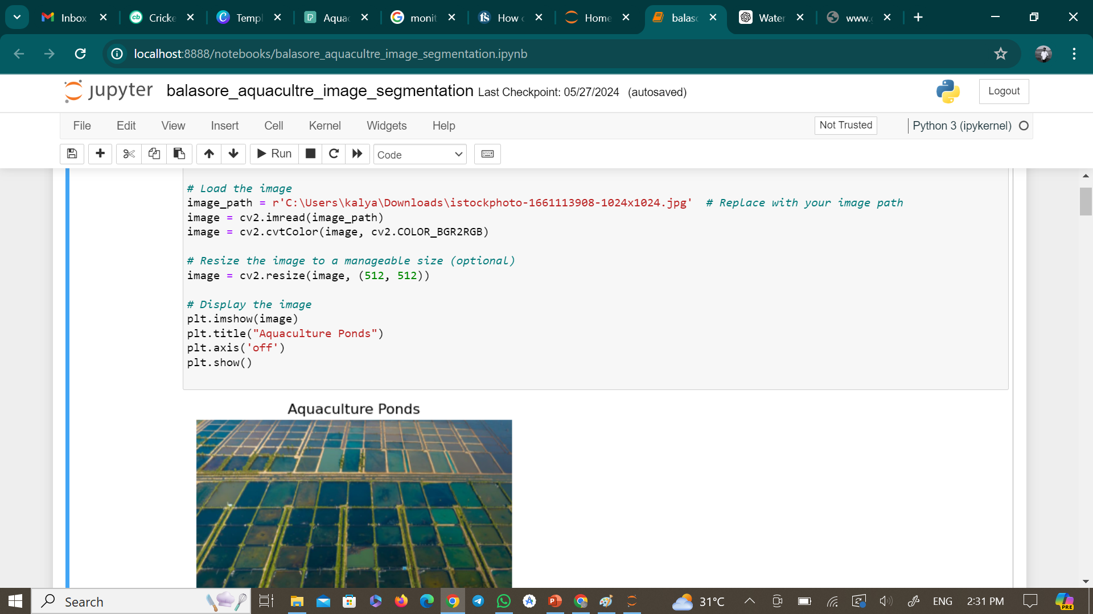
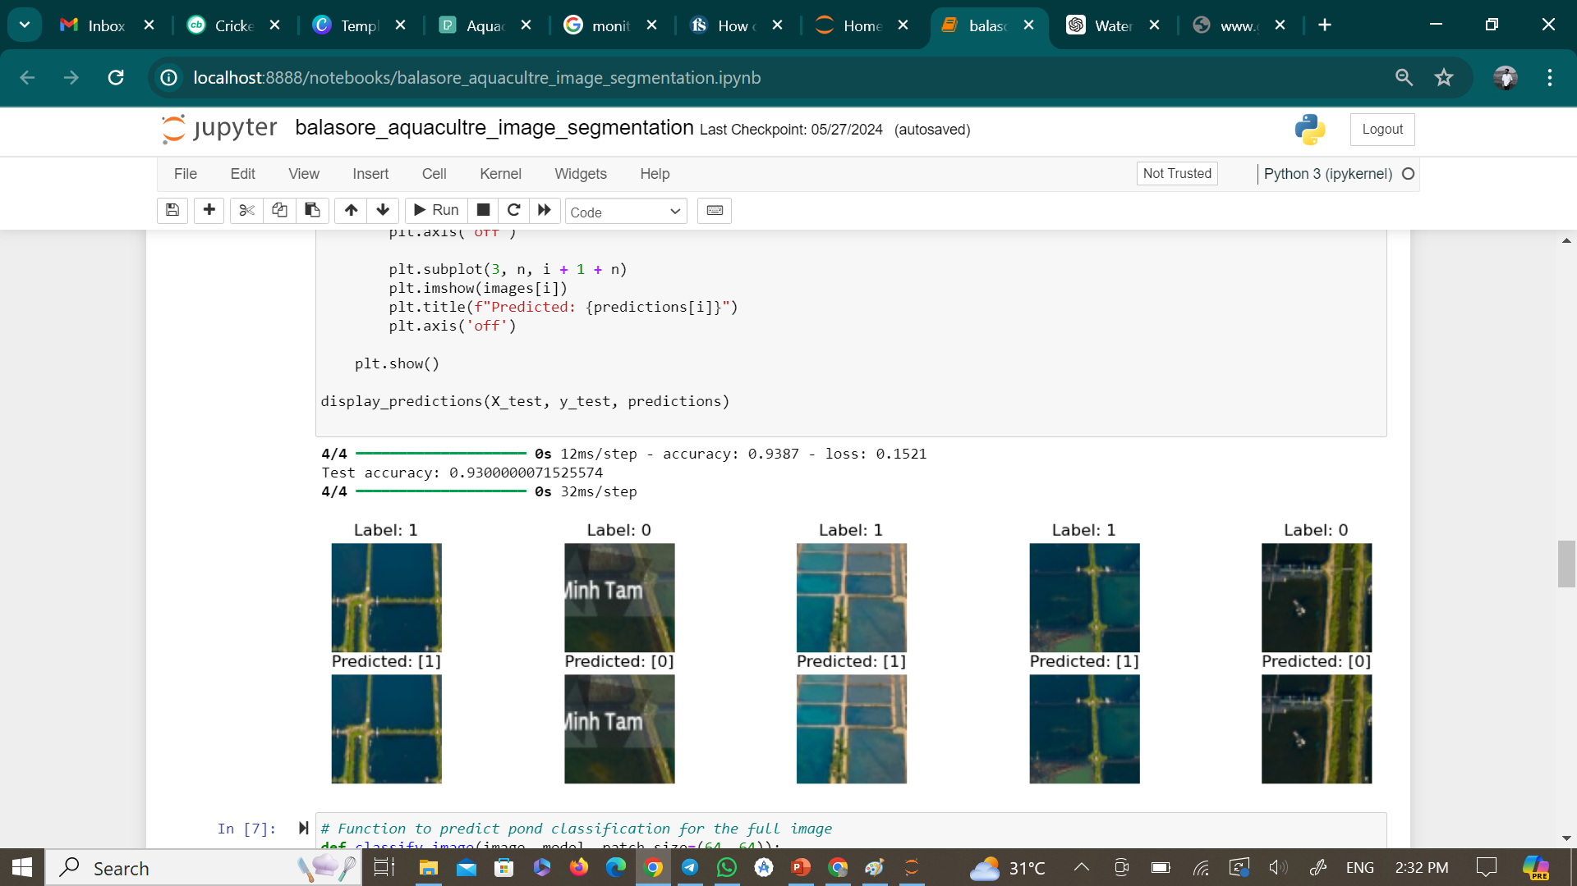
Output of the Model- Image Segmentation based

Slide 31
References
Boyd, C.E., & Tucker, C.S. (1998). Pond Aquaculture Water Quality Management. Kluwer Academic Publishers.
Boyd, C.E. (1990). Water Quality in Ponds for Aquaculture. Alabama Agricultural Experiment Station, Auburn University.
Dodds, W.K., & Welch, E.B. (2000). Establishing nutrient criteria in streams. Journal of the North American Benthological Society, 19(1), 186-196. doi:10.2307/1468291.
Carlson, R.E. (1977). A trophic state index for lakes. Limnology and Oceanography, 22(2), 361-369. doi:10.4319/lo.1977.22.2.0361.
Estimating Water pH Using Cloud-Based Landsat Images for a New Classification of the Nhecolândia Lakes (Brazilian Pantanal), by Osvaldo J. R. Pereira 1,*,Eder R. Merino 1ORCID,Célia R. Montes 2,Laurent Barbiero 3ORCID,Ary T. Rezende-Filho 4ORCID,Yves Lucas 5 and Adolpho J. Melfi 1
Bio-optical Modeling and Remote Sensing of Inland Waters, Book • 2017
Quantitative detection of chlorophyll in cyanobacterial blooms by satellite remote sensing Kutser1Department of Limnology, University of Uppsala, Norbyva¨gen 20, SE-752 36, Uppsala, Sweden
Assessment of Seasonal and Long-term Dynamics of the State of Water Bodies Using the NDTI Authors L. Plichko1, V. Zatserkovnyi1, I. Tsiupa1, N. Tarasova1 and A. Mienasova1

